Slide 1

Big Data Analytics
Case Study
RITWIK GUPTA
1JS17CS081

Slide 2


Investment Business Plan
The Story
Here is where your presentation begins

Slide 3

American Express Profile
American Express (Amex) is a global services company that provides customers with access to products, insights and experiences that enrich lives and build business success.
• Global services company
• Total assets: US $159 billion
• Annual revenues: US $34 billion
• Over 112 million cards issued

Slide 4
Our History : Customer-focused
1850
1891
1914
Travelers Cheque
Freight forwarding company
Arranging safe passage
1958
1966
1991
Launching First Charge Card
Corporate cards
Transforming Loyalty
To help adventurous and entrepreneurial customers traveling abroad feel more secure with their money
Transporting some of their most valuable possessions.
The outbreak of World War I left 150,000 Americans stranded abroad, and many turned to American Express for help. We continued to operate, cashing customers’ Travelers Cheques, forwarding their luggage and helping them arrive home safely.
2010
Pioneering Digital Commerce
Introduced their first Charge Card in the U.S. and Canada with added flexibility of credit.
To meet commercial customer needs and control over their employees’ spending.
Launched Membership Rewards®
Created American Express app in 2010 to give customers more ways to experience our service.

Slide 5

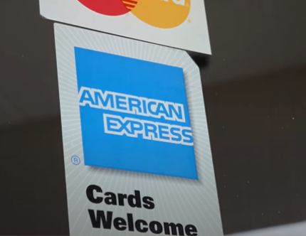
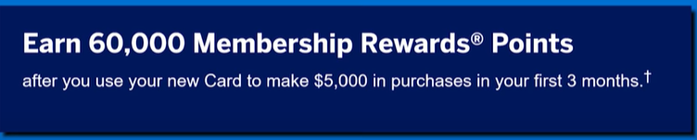
“ Spend – Centric ”
Retail Corporations
e.g. Walmart
Customers
American Express
The more you use your card the more money American Express makes.

Slide 6

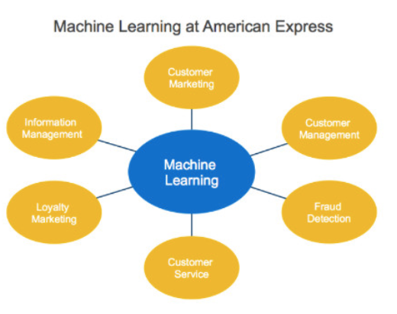
How American Express uses Big Data in practice
Data analytics, and specifically machine learning, is at the heart of American Express’s decision making. Two areas where this is evident are detecting fraud, and bringing merchants and customers closer together.
Credit card fraud detection and prevention now relies heavily on machine learning algorithms. AmEx’s goal is to detect fraudulent transactions as quickly as possible to minimize loss, so they employ a machine learning model that uses a variety of data sources, including card membership information, spending details, and merchant information to detect suspicious events, and make a decision in milliseconds by comparing that event to a large dataset.

Slide 7
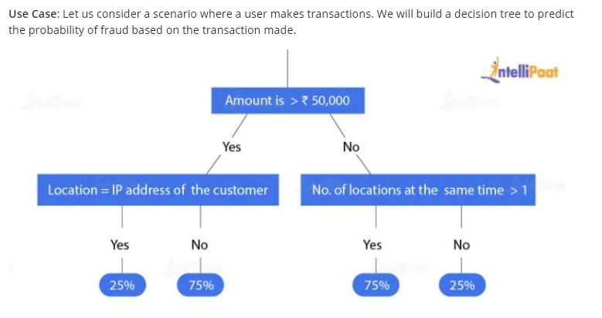
Fraud Detection Machine Learning Algorithms Using Decision Tree

Slide 8

Thank You

